Slide 1
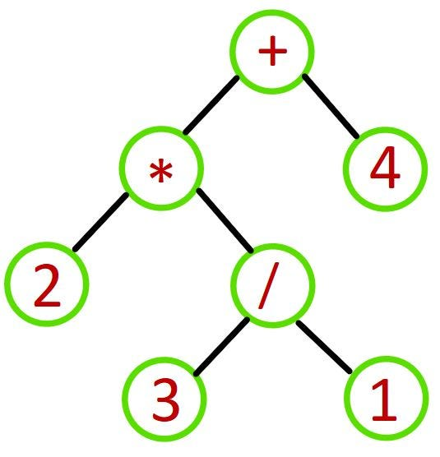

Slide 2
2
/ * 4 +
1
3
2
2 3 1 / * 4 +
POP
3 / 1 = 3
PUSH
POP
1
3
2
3 1 / * 4 +
3
2
/ * 4 +
PUSH
3 / 1 = 3
PUSH

Slide 3
3
2
* 4 +
4
6
4 +
POP
PUSH
2 * 3 = 6
POP
6
* 4 +
+
4
6
2 * 3 = 6
POP
6 + 4 = 10
PUSH
10
POP
6 + 4 = 10
PUSH

Slide 4
